Slide 1
The Life of Jesus Christ
Lesson 11 – In Galilee And Beyond
April 29, 2020
Healing of a daughter of a Canaanite woman
Matthew 15:21-28; Mark 7:24-30
Feeding of the Four Thousand
Matthew 15:29-39; Mark 7:31 - 8:10

Slide 2
Purity and Defilement
Matthew 15:1-21
“Therefore, if anyone cleanses himself from these things, he will be a vessel for honor … useful to the Master.”
(2 Timothy 2:21)
“Let us cleanse ourselves from all defilement of the flesh and spirit, perfecting holiness in the fear of God.” (2 Corinthians 7:1)
The necessity of the blood of Jesus to be cleansed!
(Hebrews 9:13-14; Ephesians 5:26)
1 John 1:6-9, “… if we walk in the Light as He Himself is in the Light, we have fellowship with one another, and the blood of Jesus His Son cleanses us from all sin. If we say that we have no sin, we are deceiving ourselves and the truth is not in us. If we confess our sins, He is faithful and righteous to forgive us our sins and to cleanse us from all unrighteousness.”
Notes:
Does speak of what we must do each time commit any type of sin. (Confess and repent)
Cleansing is continuously available but conditionally given!
Heb 9:13-14
For if the blood of goats and bulls and the ashes of a heifer sprinkling those who have been defiled sanctify for the cleansing of the flesh, 14 how much more will the blood of Christ, who through the eternal Spirit offered Himself without blemish to God, cleanse your conscience from dead works to serve the living God?

Slide 3
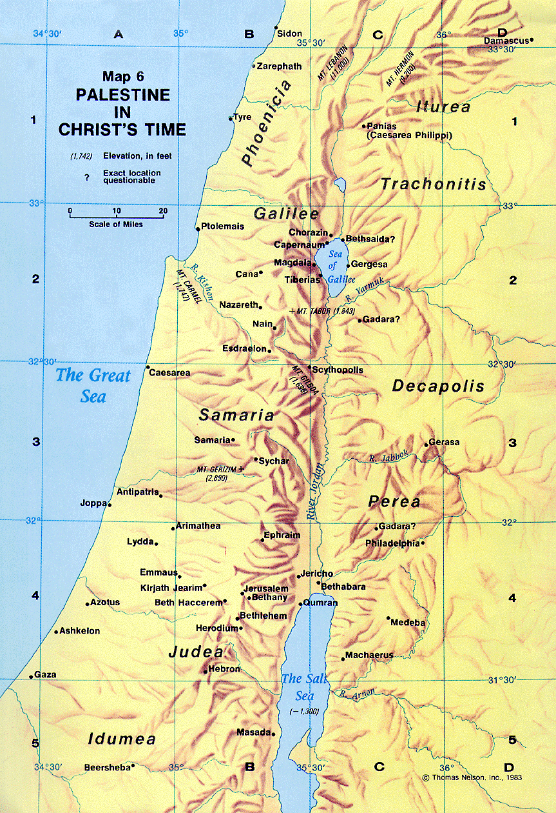
Healing a Canaanite Woman’s Daughter
Matthew 15:21-28
“Jesus went away from there into the district of Tyre and Sidon.”
cf. Matthew 11:21-22; Luke 4:23-30; 6:17; Acts 21:1-7
Prophecy: Ezekiel 26:3-21
Notes:
TYRE - Ezekiel prophesied the destruction of Tyre (Ezek 26:3-21). The first stage of this prophecy came true when Nebuchadnezzar, king of Babylon, besieged the mainland city of Tyre for 13 years (585 B.C. - 572 B.C.) and apparently destroyed it. However, Nebuchadnezzar had no navy; so he could not flatten the island city. But losing the mainland city was devastating to Tyre. This destroyed Tyre's influence in the world and reduced her commercial activities severely.
The second stage of Ezekiel's prophecy was fulfilled in 332 B.C., when Alexander the Great besieged the island city of Tyre for seven months. He finally captured it when he built a causeway from the mainland to the island. Hauling cedars from the mountains of Lebanon, he drove them as piles into the floor of the sea between the mainland and the island. Then he used the debris and timber of the ruined mainland city as solid material for the causeway. Hence, the remarkable prophecy of Ezekiel was completely fulfilled.
(Nelson's Illustrated Bible Dictionary)
We are reminded here of Elijah’s sojourn in Phoenicia during the drought in the days of Ahab and Jezebel (cf.
1 Kings 17:9-24). After the murder of John, the Elijah who was to come (11:14), Jesus had attracted the attention of Herod. Herod and Herodias had acted with the wickedness of Ahab and Jezebel (see 14:5). Like Elijah, Jesus will now sojourn among the Gentiles and find among them those who demonstrate a type of faith lacking
among many in his own homeland.
ZAREPHATH - [ZAR eh fath] (place of dyeing) - a Phoenician coastal city situated between Tyre and Sidon (see Map 4, B-2), where the prophet Elijah lodged with a widow (1 Kings 17:9-10; Obad 20; Luke 4:26; Sarepta, KJV). The widow of Zarephath showed great faith in feeding Elijah during a time of severe drought and famine. Her faith was rewarded, for her "bin of flour was not used up, nor did the jar of oil run dry" (1 Kings 17:16).
(Nelson's Illustrated Bible Dictionary)

Slide 4
Healing a Canaanite Woman’s Daughter
Matthew 15:21-28
“A Canaanite woman from that region came out and began to cry out, saying, ‘Have mercy on me, Lord, Son of David; my daughter is cruelly demon-possessed.’” (verse 22; cf. Luke 18:25-39)
Jesus does not respond but His disciples, as they “implored Him saying, ‘Send her away, because she keeps shouting at us.’” (verse 23)
What does this woman’s address of Jesus say about her? (Mark 12:35; Matthew 9:27; 12:23)
Notes:
Mark 12:35 - And Jesus began to say, as He taught in the temple, "How is it that the scribes say that the Christ is the son of David?
Matt 22:41-42 - Now while the Pharisees were gathered together, Jesus asked them a question: 42 "What do you think about the Christ, whose son is He?" They said to Him, "The son of David.“
Matt 9:27
As Jesus went on from there, two blind men followed Him, crying out, "Have mercy on us, Son of David!"
Matt 12:22-23 - Then a demon-possessed man who was blind and mute was brought to Jesus, and He healed him, so that the mute man spoke and saw. 23 All the crowds were amazed, and were saying, "This man cannot be the Son of David, can he?

Slide 5
Healing a Canaanite Woman’s Daughter
Matthew 15:21-28
Jesus finally responds to the woman saying,
“I was sent only to the lost sheep of the house of Israel.” (verse 24; cf. Matthew 10:5-6; Acts 1:8; 3:26; 13:46; Romans 1:16; 2:9-10)
The woman’s response: “She came and began to bow down before Him saying, ‘Lord, help me!’” (verse 25)
Accepted by Jesus. (Matthew 4:10; 8:2; 9:18)
Do we see the desperate need for Jesus’ help as she did? (Hebrews 4:16; cf. Psalms 46:1; 109:26-27; 119:173; 145:17-18)
Notes:
His own disciples refused to accept homage from others (Acts 10:25-26; 14:15) but offered it to Jesus (28:9; 28:17; Luke 24:52).
Ps 119:173, “Let Your hand be ready to help me, for I have chosen Your precepts.”
Ps 109:26-27 - Help me, O Lord my God; Save me according to Your lovingkindness. 27 And let them know that this is Your hand; You, Lord, have done it.
Ps 145:17-18 - “The Lord is righteous in all His ways, And kind in all His deeds. 18 The Lord is near to all who call upon Him, To all who call upon Him in truth.”

Slide 6
Healing a Canaanite Woman’s Daughter
Matthew 15:21-28
Jesus responded saying, “It is not good to take the children’s bread and throw it to the dogs.” (verse 26)
An expression: (Matthew 7:6)
Who is to receive the blessing of a meal first, the children or the family pet?
  Jesus is simply speaking of the sequence of God’s divine plan. To the Jews first.
Does Jesus know her heart?
Notes:
Matt 7:6 - Do not give what is holy to dogs, and do not throw your pearls before swine, or they will trample them under their feet, and turn and tear you to pieces.
Kunarion is the diminutive form of kuon, thus lit. “little dogs” (NKJV). This indicates, “a house-dog or a lap-dog in contrast to a dog of the street or farm” (BAGD).
“All that Jesus does is to ask the disciples and the woman to accept the divine plan that Jesus must work out his mission among the Jews.... Any share of Gentile individuals in any of these blessings can only be incidental during Jesus’ ministry in Israel
“The sort of language she might expect from a Jew in order to see how she would react.”
It is as if she did not care about anything other than that this Prophet can help her daughter and she will not be dissuaded . . . . It would have been easy for her to turn away in anger or sorrow or pride. But she saw Jesus as the only hope for her daughter. She would not turn away!
Our use of “dogs” as common expressions:

Slide 7
Healing a Canaanite Woman’s Daughter
Matthew 15:21-28
The woman then responds: “Yes, Lord; but even the dogs feed on the crumbs which fall from their masters' table.” (verse 27)
“Yes” – a “strong affirmation” (Strong) “Yea, verily, even so” (Vine) She agreed with Jesus.
She yet persisted in her pursuit.
Even if just the “crumbs,” she desperately wanted what only Jesus could provide.
Notes:
Even those not intended for the meal enjoy some of the blessings.

Slide 8
Healing a Canaanite Woman’s Daughter
Matthew 15:21-28
Jesus then observes and remarks: “O woman, your faith is great; it shall be done for you as you wish.” (verse 28)
Great faith! (Matthew 8:10; 9:22)
Recognizing the divine order of the Father, she believed Jesus could still grant this miracle.
“Blessed is he who doesn’t take offense at Me.”
(Luke 7:23, cf. John 6:61; Matthew 15:12)

